Slide 1
Background
NIEM PMO & GTRI are working on the plan now for a NIEM 3.0
NIEM model harmonization is a significant piece of the work, and is primarily scope of the NBAC
NBAC needs a process & plan for our effort
We need to get moving on the harmonization effort

Slide 2
Feedback From GTRI
We expect NBAC and domains to work through their own harmonization and change issues - even self-organize to meet with other domains whose components may semantically overlap. We will stand ready to facilitate, assist, and answer questions as needed, but our intent and responsibility is to integrate the change inputs, make minor adjustments (not major rework) where needed, adjust to 3.0 architecture as necessary, run final conformance and quality checks, provide guidance for any required after action, and keep the process moving.
How NBAC and domains prioritize and resolve their issues (whether through meetings, tiger teams, individuals, etc.) should be their business but coordinated under the plans (timelines and mechanisms).

Slide 3
NBAC Process for NIEM 3.0 Harmonization (N3H)
Preliminary Draft for Review

Slide 4
Objectives
Define and implement a simple but effective process for NBAC’s activities in support of NIEM 3.0 harmonization effort
Facilitate Domain harmonization efforts
Engage the broader NIEM Community for participation and inputs
Objective of harmonization is to make the NIEM model cleaner, easier to understand, and easier to use.

Slide 5
Harmonization Categories
A. Domain to NC Harmonization
B. Internal NC Harmonization
C. Domain to Domain Harmonization

Slide 6
Harmonization Kinds
Type Addition – Type does not currently exist in NC, and addition will not impact existing types/properties
Property Addition – adds new element or attribute to an existing type in NC ,and addition will not impact existing types/properties. Includes additions to substitution groups.
Replacement – replaces existing type and/or property, and replacement will not impact other existing types/properties
Revision – change to the name and/or semantic description of a type/property, and revision will not impact other existing types/properties
Realignment – harmonization requires restructuring beyond a type/property addition, replacement, or revision.
Deletion – removal from NC and movement to a Domain

Slide 7
N3H Process Considerations
Time period allotted in N3.0 schedule will be constrained – we need to start asap without waiting for the N3.0 official Kick-off
Proposed items for harmonization will dribble in -- process needs to support this reality
Harmonization work will be done via NBAC subteams. Issues that cannot be resolved will have an escalation process to the NBAC.
NBAC has governance responsibility and final decision on what gets harmonized into and out of NIEM Core
NBAC is the gatekeeper on what goes to GTRI – the NBAC Process needs to interface with the GTRI process and Domain processes for producing NIEM 3.0
Process needs to be simple and decentralized to workgroups/teams for execution
Engage NIEM Community participation/awareness

Slide 8
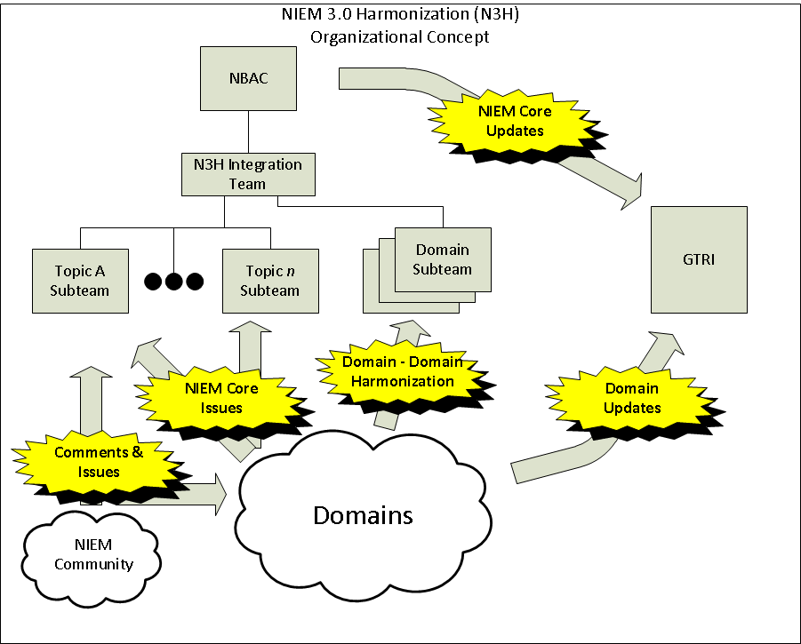

Slide 9
Get Started Tasks
Define harmonization process (draft reviewed today)
Establish duration timelines for process steps (timebox events)
Select start date and create milestone schedule
Revise as needed when NIEM 3.0 plan becomes available

Slide 10
Process Steps for Categories A & B
1. Identify Harmonization candidates
1.1 Create a standard form to be used by all to identify the candidates
1.2. Each domain identifies types/properties they recommend for harmonizing into NIEM Core from their domain.
1.3. Anyone can propose NC types/properties for internal NC Harmonization
1.4. Each domain identifies types/properties they wish to harmonize with other domains
1.5. GTRI culls out harmonization items currently in NCCT and allocates to one of the three types of harmonization.

Slide 11
Process Steps (cont.)
3. Prepare Subteams
3.1 Establish harmonization subteams for each 'topic '
There may be more than one topic per subteam.
Domains self-select onto subteams whose topics are important to the domain.
Also need an ‘integration’ subteam that provides oversight of the work of all the subteams and seeks to identify and resolve potential conflicts/collisions.
3.2 Define screening criteria to eliminate or keep candidates for harmonization

Slide 12
Process Steps (cont.)
4. Subteams then:
4.1 Review candidates for each topic area (from step 1 above) and
eliminate candidates using the screening criteria (3.2 above) (and document rationale for elimination)
review NC and identify existing NC types/properties that fit the topic area
4.2 Create description of the proposed harmonization changes and draft taxonomy for the topic area using the results of 4.1
4.3 Post to N3 harmonization website for initial public comment

Slide 13
Process Steps (cont.)
5. Public Comment on Pink Draft
6. Adjudicate Comments and Create Gold Draft
7. Public comment and Vote on Gold draft
8. NBAC review and make decisions, considering the Public Vote results
9. Package and deliver to GTRI

Slide 14
Demo
Pilot Website to support process execution

